Slide 1
Evergage Demo Draft
7/13/20
Deloitte Digital

Slide 2
Web campaigns and Templates

Slide 3
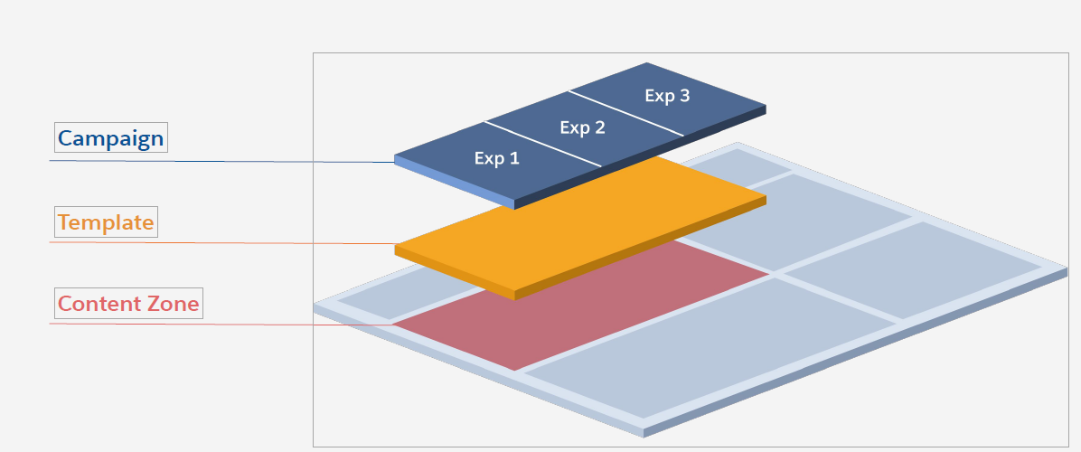
Setting up a campaign
As a part of this POC, we configured a web campaign. Below are the components:
Content Zone:
An area on the site that has been mapped to make it eligible for personalization. This is coded in the sitemap and can include zones like CTA button, Homepage Hero, etc
Template- The template code decides what is rendered on the content zone selected and also what components a Business User can configure
Campaign-Compinet that is configurable by a business user. Allows selection of a template, completing the inputs available to them, & then publishing the campaign. The published campaign is visible to prospects/customers that qualify based on the testing/targeting logic.

Slide 4
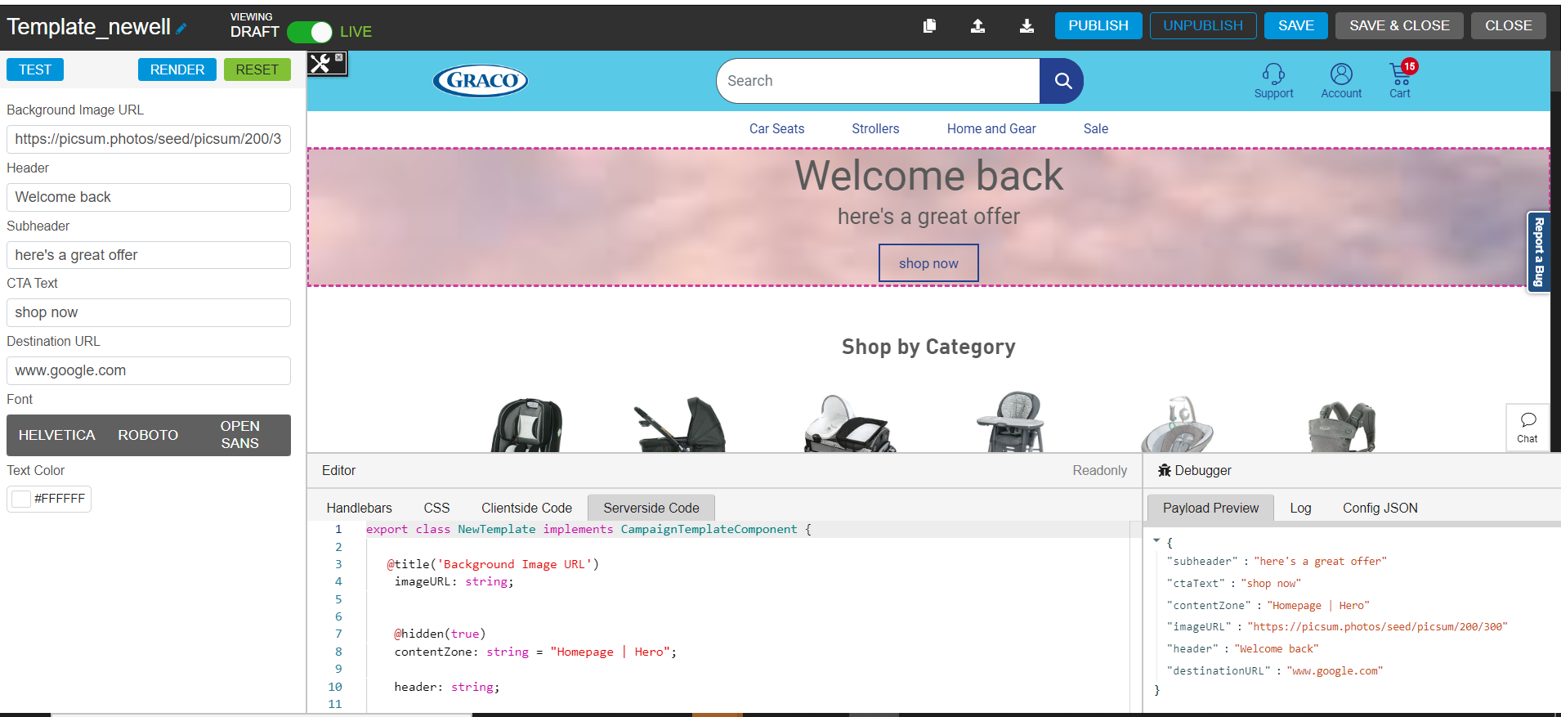
Template config
The editor at the bottom of the screen is where a developer can code the components of the template.
The pane on the left is a view of the components the business user can configure and define when they setup the campaign. This is coded in the SSJS section of the editor.

Slide 5
A/B Test Campaigns

Slide 6
Template config
The editor at the bottom of the screen is where a developer can code the components of the template.
The pane on the left is a view of the components the business user can configure and define when they setup the campaign. This is coded in the SSJS section of the editor.

Slide 7
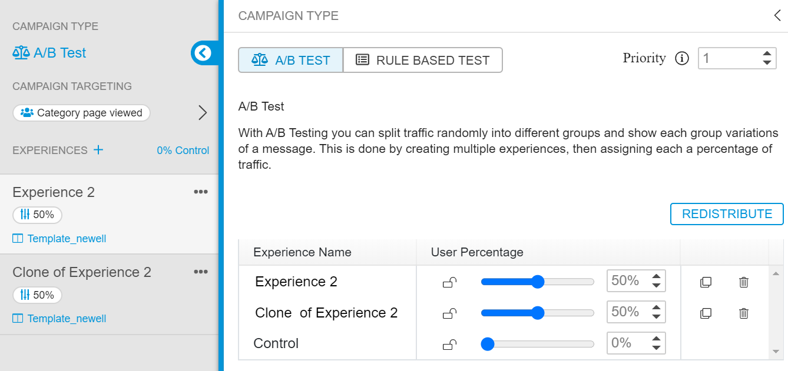
Creating an A/B Test
Under Web campaign , select A/B Test as Campaign Type.
Under Campaign Targeting section, select the Rule to qualify a user for this campaign.
We can select the User segments as well.
Add a template to the experience, Enter the details to be rendered as a part of Campaign.
Set the distribution % of users for the experience.
Repeat the above two steps to add multiple experiences.

Slide 8
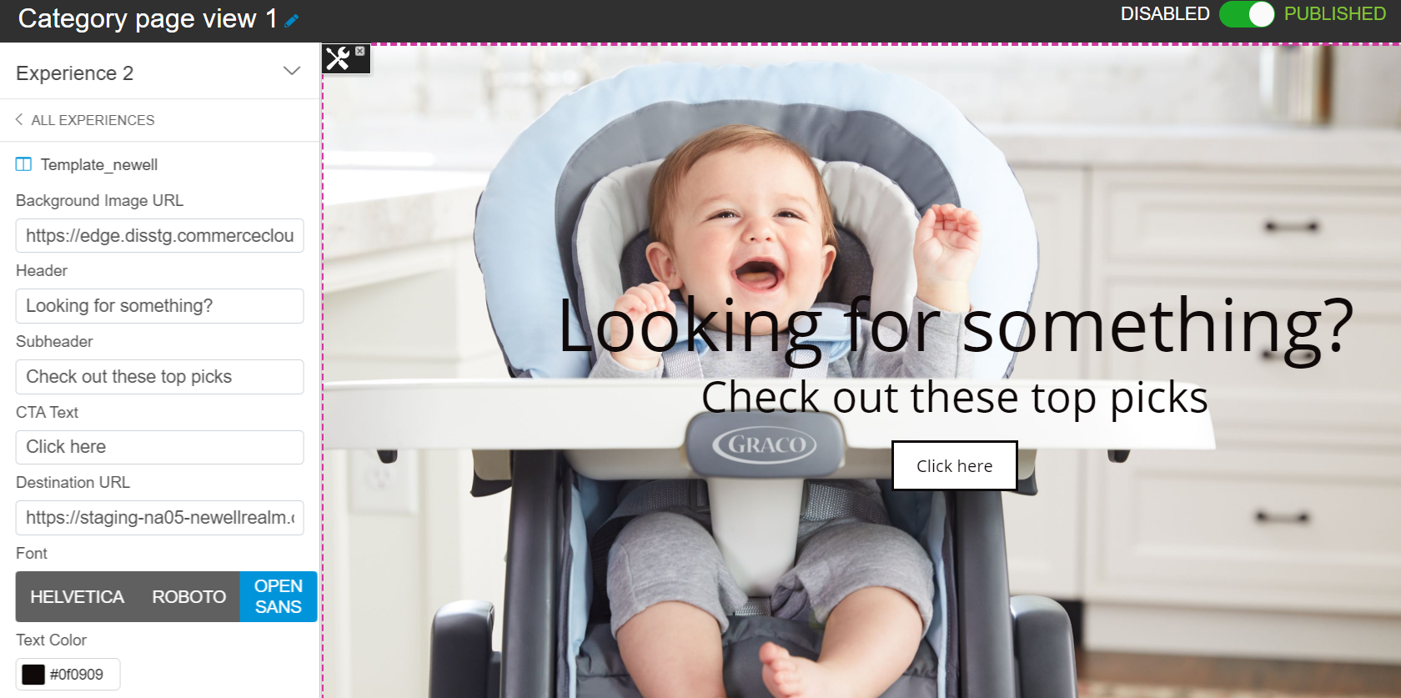
Editing experience in A/B Test
Once a template is added, all the fields will be available for editing from business user perspective.
Add the respective details and use test URL / Visual Editor to validate the look and feel of the experience.

Slide 9
Sitemap & Catalog

Slide 10
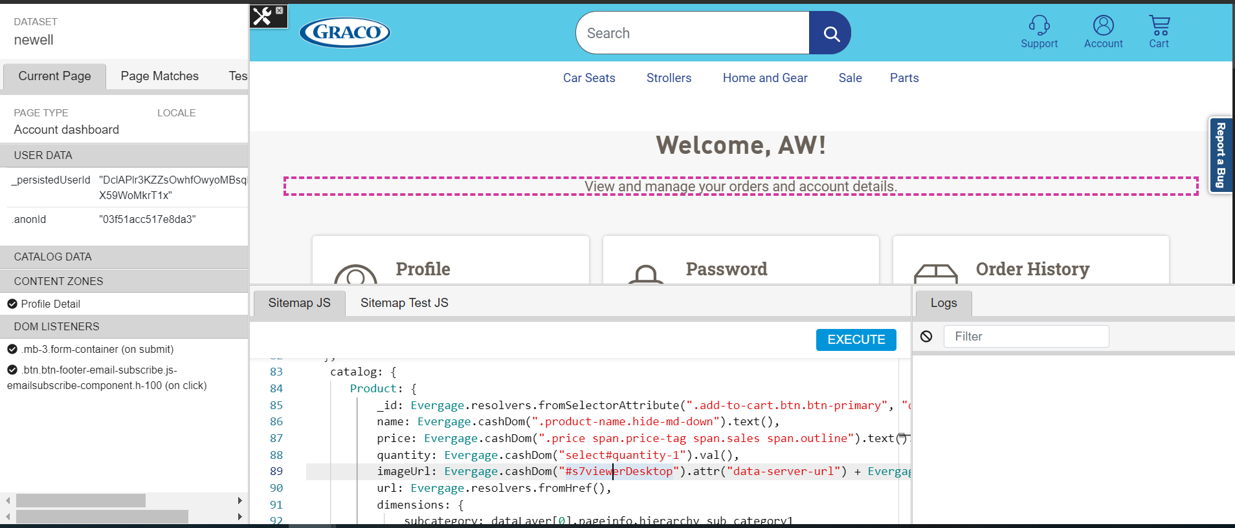
Sitemap
Used for mapping from 1st party source & website :
Sitemap system is a configuration driven integration layer that is deployed by and executes within the Evergage beacon.
It is developed to integrate with a specific site using the APIs provided, which map key business objects into the Evergage system through event capture.
This can include page type information and catalog items, supporting the ability to understand user interests against the catalog.
It includes items such as products, article content, and categories, and can also include custom dimensions (categorical information about items with custom attributes).

Slide 11
Activities in Sitemap.
Mapping out Content Zones.
Creating Page Level Configs.
Mapping de-anonymized user actions.
Mapping event such as add-to-cart etc. and related product line item.
Mapping Catalog Data using Bottom-Up approach from DOM scrapping.

Slide 12
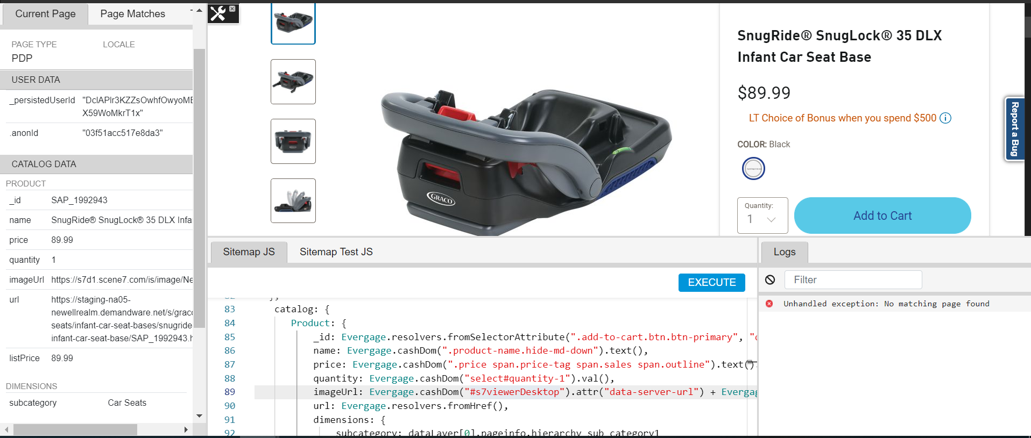
Catalog Setup
Creating a Product catalog using Sitemap configurations from PDP views.
Bringing in Product data such as – id, name, price, quantity, category and image dynamically.
Building Product affinity in the evergage UI.

Slide 13
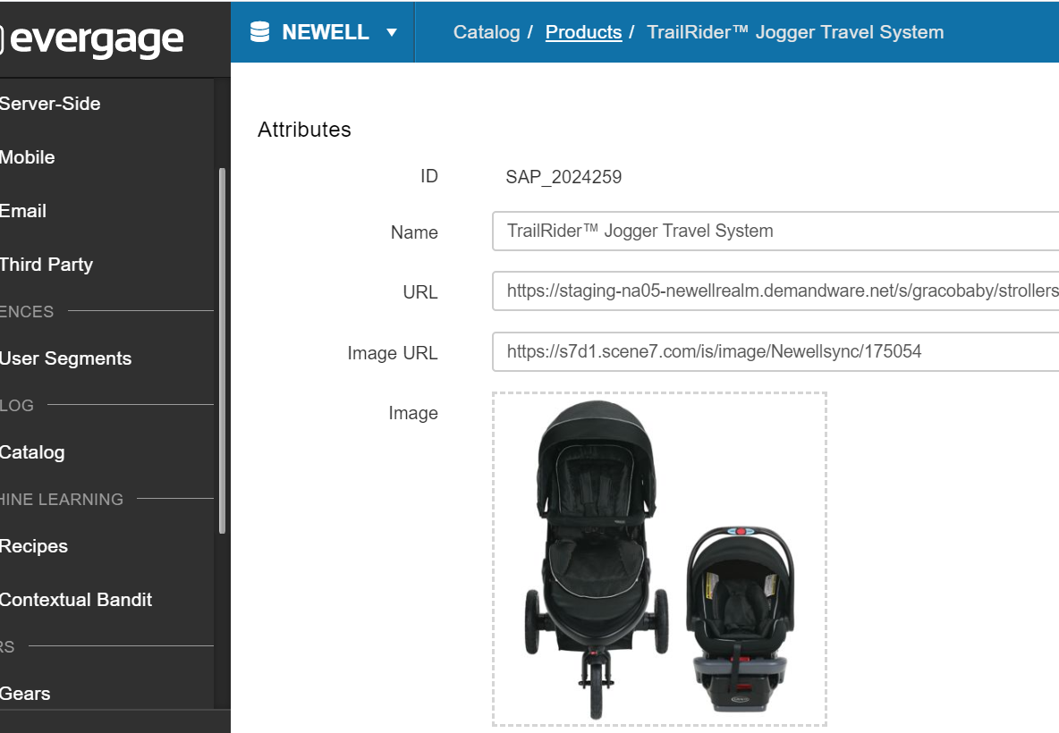
Catalog in Evergage
Product line Item displayed under Catalog -> Products section.
Attributes Captures:
Id
Name
Product URL
Image
Price
Quantity (on add to cart)
Product Category.

Slide 14
Unified Customer Profile

Slide 15
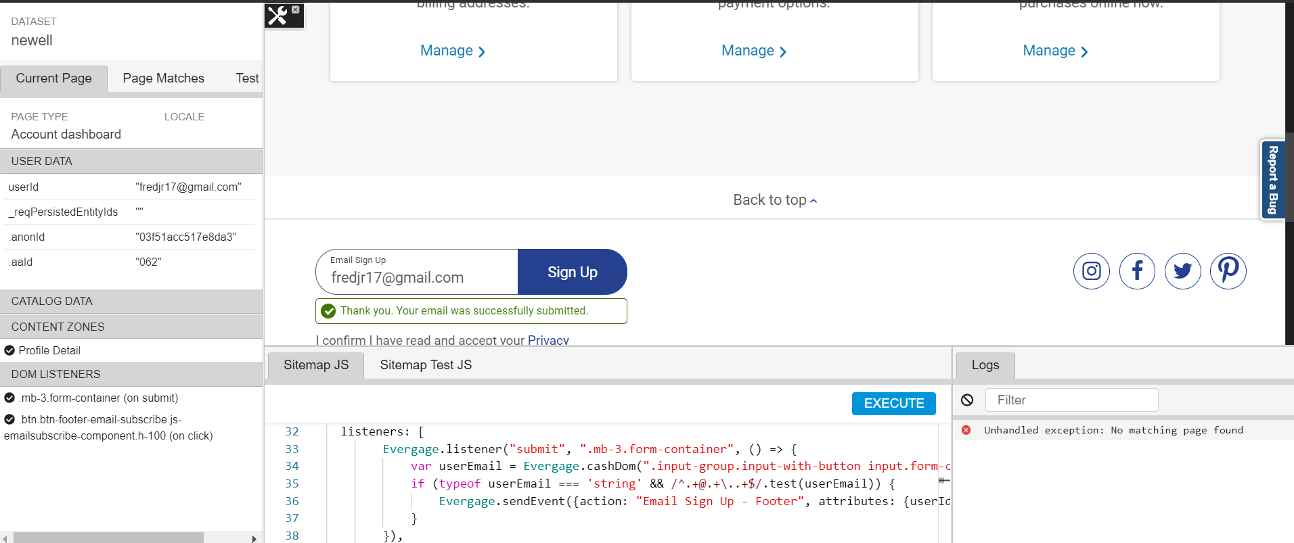
Building Customer Profile
Using Sitemap to build customer profile and de-anonymizing users.
Using Evergage’s event listener and action to pass on user attribute against an anonId and de-anonymize it .
Creating a Unified customer Profile in Evergage.
Event steams tied with the user.
Product affinity details of the user.

Slide 16
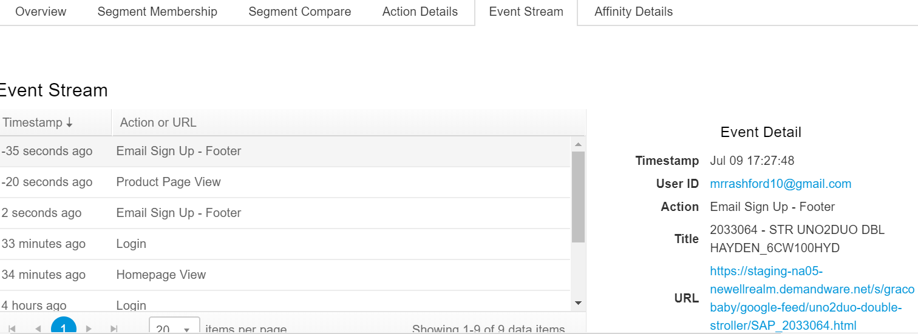
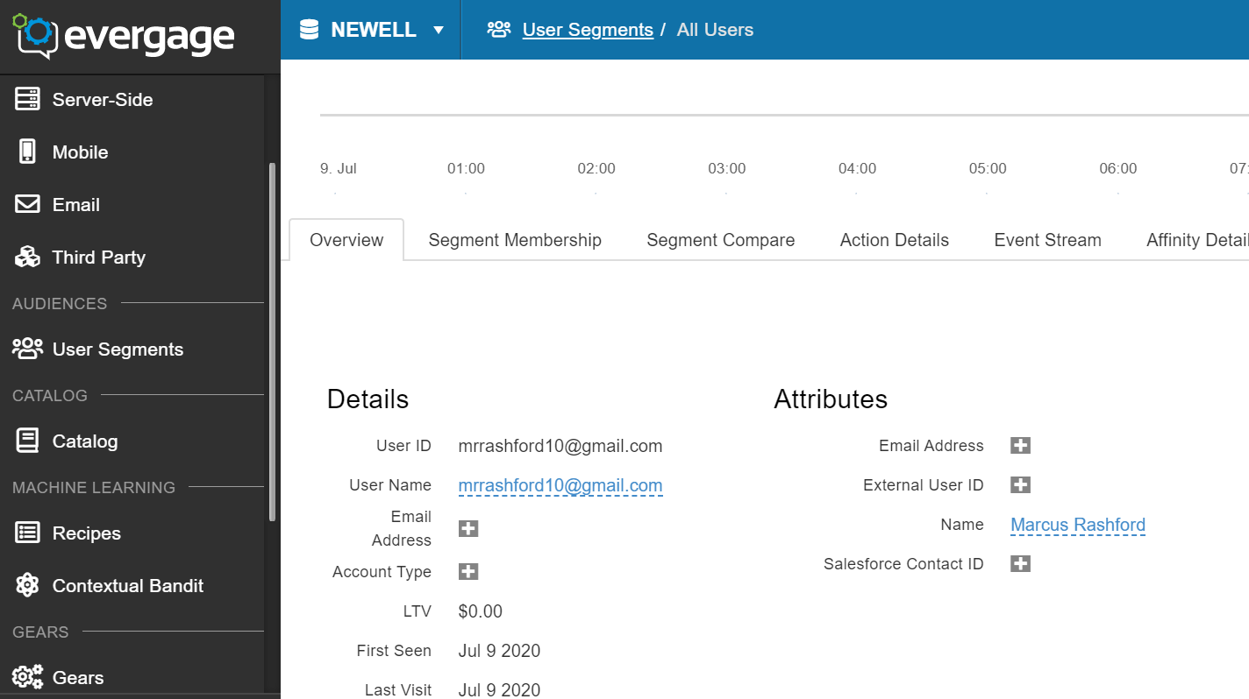
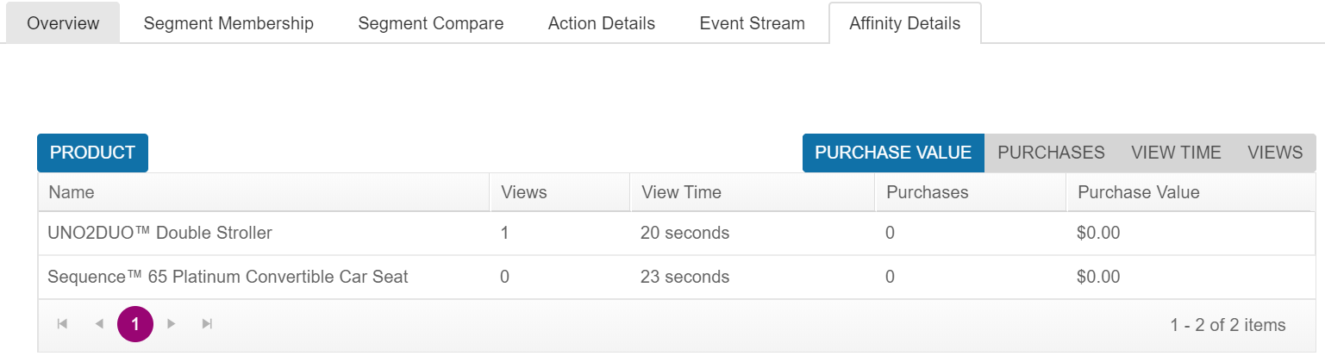
User Profile in Evergage
All users can be seen by navigating to User Segments -> All Users. (Anonymous + Known Visits)

Slide 17
Gears

Slide 18
What is a Gear
An extension platform you can use to add custom business functionality to the Evergage platform.
Allows to integrate the Evergage platform with other systems, add functionality to extend the core capabilities and take advantage of reusable templates and access the rich analytics data stored in your Evergage account.
All Gears are custom coded in TypeScript.
Gears can be used as a connector, import/export reusable code, extensions to connect to email campaigns , mobile app data etc.
There are core gears already installed in an account. For e.g. the default templates available for campaigns.

Slide 19
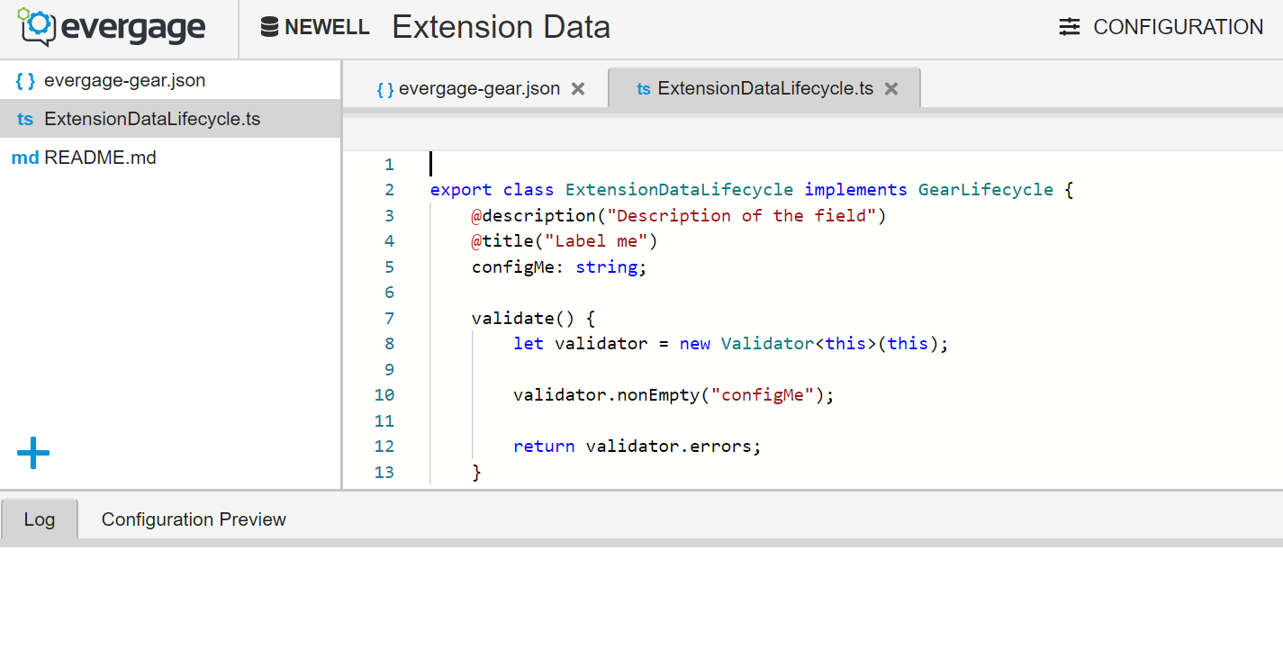
Creating Gears
Navigate to Gears and select “New Gear” to use the Evergage’s editor to create a new one or “Upload Gears” to upload a typescript File.
Any user with Admin access can create or modify gears.
All pre-installed gears can be seen in the Gear dashboard.

Slide 20
Open Items

Slide 21
Findings
One of the key findings of this POC is related to non-persistence of de-anonymized id on subsequent visits. Issue has been raised with Salesforce Support to assist on the same in our Newell Dataset.
Limitations of Evergage’s Dev sandbox to read Dynamic Data Layer- only the datalayer attributes/values available on page load can be retrieved and used.
General Dataset Flag Settings. We are in touch with salesforce to correctly enable the flag as per our requirements.
Reporting capabilities associated with a Dev sandbox.
Of late, once settings were changed by Evergage for our dataset, we have been unable to tie actions back to email addresses passed in sitemap. It is being assigned to anonymous id only.

